Slide 1
DATA ANALATICS AND CONGOS
PRODUCT SALES AND ANALATICS

Slide 2
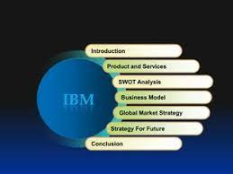
Introduction

Slide 3
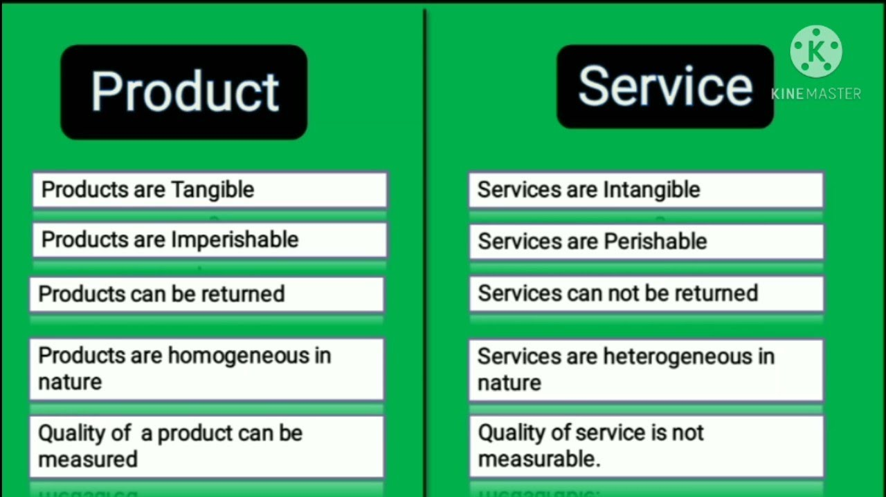
Product and services

Slide 4
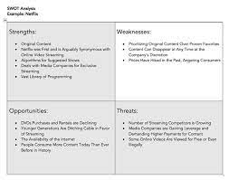
SWOT

Slide 5
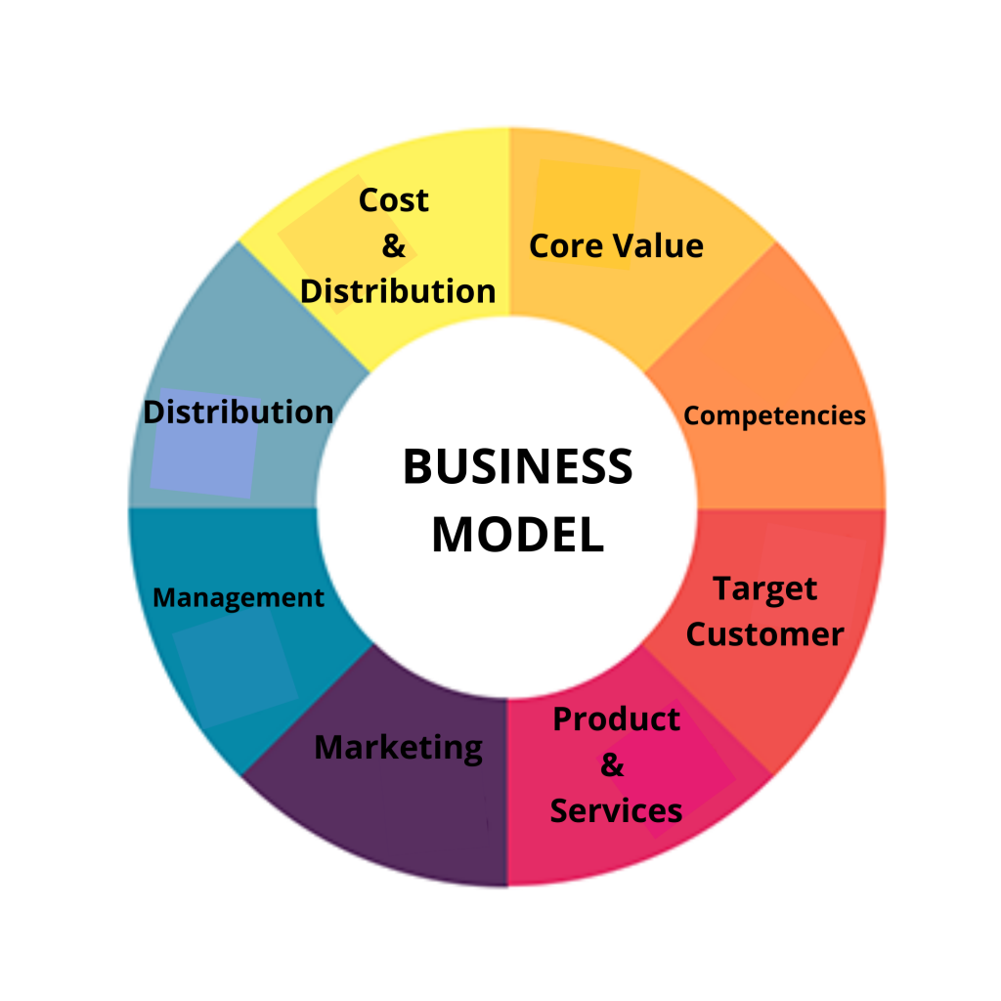
Bussiness model

Slide 6
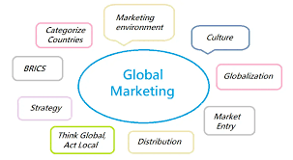
Gobal market strategy

Slide 7
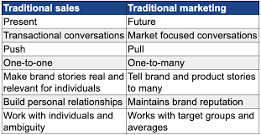
Future sales

Slide 8
Conclusion
The section provide a summary of product analysis report
It should highlight the more critical findings from the report and outline what action should be taken based on those finding.

